Slide 1

Interpreter Pattern
Dmytro Razvaliaiev
Vistula University

Slide 2
What Interpreter Pattern is about?
Interpreter pattern provides a way to evaluate language grammar or expression.
It helps to convert information from one language into another.
The language can be anything such as words in a sentence, numerical formulas or even software code.
This pattern involves implementing an expression interface which tells to interpret a particular context.
This pattern is used in SQL parsing, symbol processing engine, software for HRs etc.

Slide 3
Definitions
A Non-Terminal expression is a combination of other Non-Terminal and/or Terminal expressions.
Terminal means terminated, i.e., there is no further processing involved.

Slide 4
An example
An example expression is A + B
The A and B are Terminal expressions and the + is Non-Terminal because it depends on the two other Terminal expressions.

Slide 5
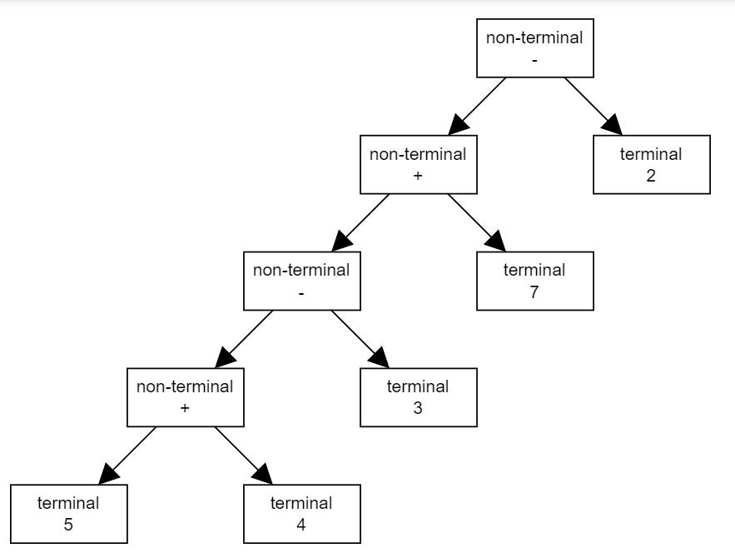
The Image below, is an AST for the expression: 5 + 4 – 3 + 7 - 2

Slide 6
Terminology
Abstract Expression: Describe the method(s) that Terminal and Non-Terminal expressions should implement.
Non-Terminal Expression: A composite of Terminal and/or Non-Terminal expressions.
Terminal Expression: A leaf node Expression.
Context: Context is state that can be passed through interpret operations if necessary.
Client: Builds or is given an Abstract Syntax Tree to interpret.

Slide 7
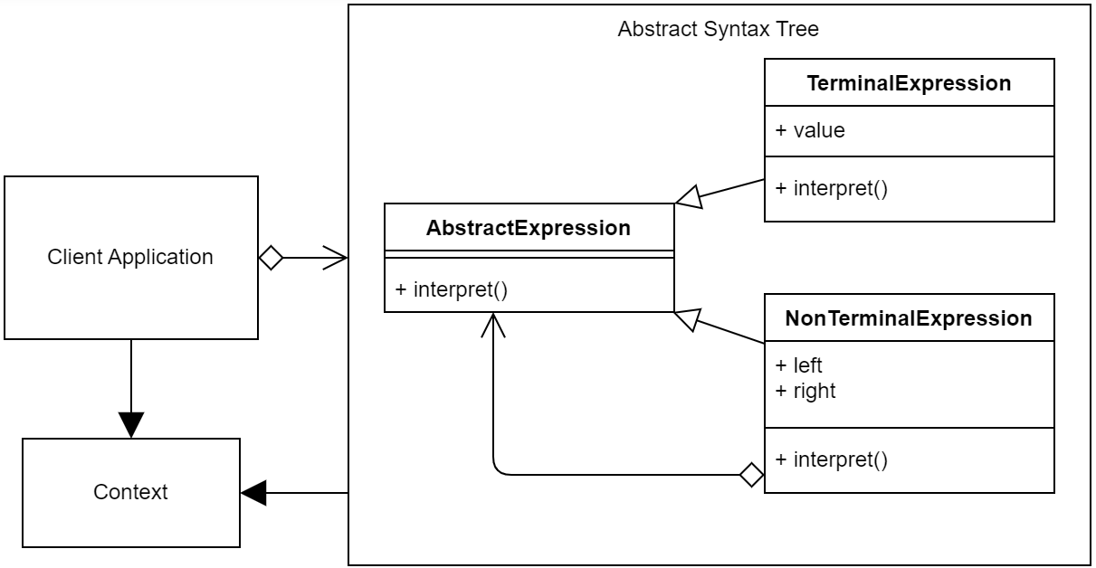
Interpreter UML Diagram

Slide 8
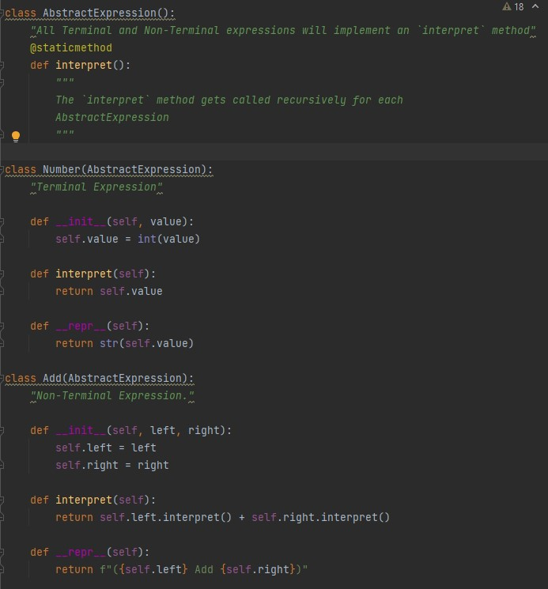
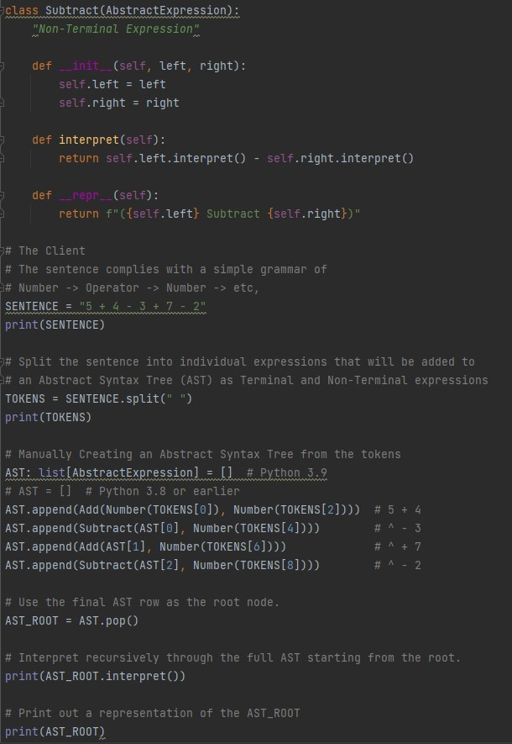
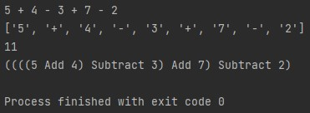
Code implementation

